Slide 1
Consequences from new products on up-stream processes (WP1)
Morgan Vuillermoz, Guillaume Legrand
FCBA
EU Hardwood meeting June 2016

Slide 2
Consequences from new products on up-stream processes Principle
Description of the « ideal lamella » for glulam production and specific glulam design
Questions to be tackled :
Current production costs and value on the market (at primary processing including round wood supply, and secondary processing)
Availability of strength graded sawn-products (as a sawmill output and up-stream in the forests)
Identification of the gaps with current production conditions in terms of organization and material (at primary processing and secondary processing)
Foreseeable changes in production conditions and adapted lamella specifications (compromise)

Slide 3
Consequences from new products on up-stream processes Status and plan for next months
Production of GL24h glulam out of homogenous quality (D24 square-edged timber)
Square-edged timber specified from the sawmill
Interviews at SIMONIN (glulam manufacturer) and MUTELET (sawmill)
Production costs and organization constrains documented (deliverable : july 2016)
Production of GLXXc glulam out of mixed qualities (D18, D24, D30, D40)
Mid-size/age round wood specified from the forest
Inner / outer lamellas and their weight in the sawmilling and glulam production process, and final product performances
Production costs and organization constrains documented (deliverable : october 2016)
Foreseeable changes for sawmilling and glulam production documented (hopes & beliefs vs facts)

Slide 4
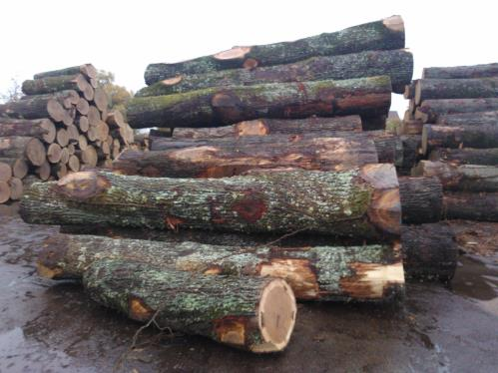
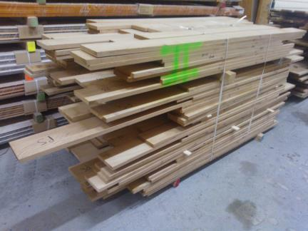
1st production (2015) Questions
Can traditional square-edged timber produced from 2nd logs fulfil expectations towards “ideal” lamella for glulam production ?
And what are the consequences along the chain ?

Slide 5
1st production chain (2015) Material
Traditional square edged timber oak
Section : 27 ± 1 x 160 mm
Length : 1.6 to 2 m
Moisture content: 10-12%
Aesthetics: QF2/3 (acc. to EN 975-1)
Strength grading through equivalence D24 by FCBA acc. to NF B52.001
Time before delivery: 3 weeks
Volume: 20 m3

Slide 6
1st production (2015) Resource - dependent differences in the glulam process
To be finalized
Lots of qualitative aspects…
Non standard conditions for the glulam production

Slide 7
1st production (2015) Feedback from the supplier (oak sawmill)
High expectations fulfilable only under adapted conditions:
Time for delivery
Mix of lengths and qualities (what to do with the rest?)
Clear specifications on the square edged timber
…
Otherwise, additional costs to be supported by the client:
+ 40% when lamellas are produced from selected un-edged timber (butt log)

Slide 8
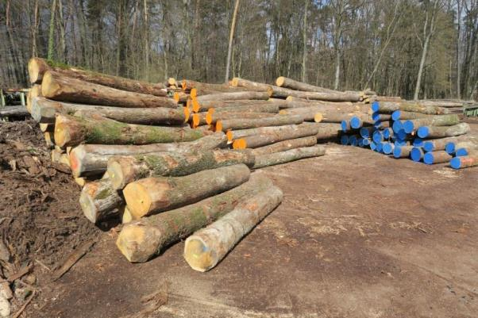
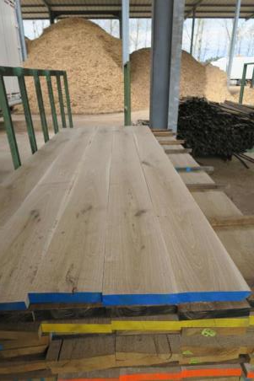
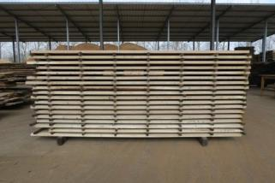
2nd production (2016) Questions
Can chosen GLxx glulam design be produced from purposely-specified round wood and what are the consequences along the chain ?

Slide 9
2nd production (2016) Design and monitoring
Willingness to make the most from wood resource both for round wood & sawn timber
Lessons learnt from earlier national study : mid size/age oak
Need valorization
Best mechanical characteristics
Purpose-driven round wood specifications used to identify a suitable batch → D2b - D3 from auction catalog (ONF FD - Sarrebourg)
Purpose-driven sawing and processing at sawmill used to deal with such diameter / quality class (Trendel - Haguenau)
Strength grading and sawing quality (FCBA for Trendel)
Inhomogeneous glulam production (Simonin – Montlebon)
+ Qualitative feedback collection along the production chain

Slide 10
Next steps…
Finalize 2nd production
Clarifications on the production costs
Lab results on the beams
Dialogue with industry
Organize relevant dissemination
Technical report together with participating companies (Simonin, Mutelet, Trendel and ONF)
Transfer of lessons learnt to a wider group: to be arranged with Federations (Sawmillers & GL producers)
Plan for the future (implementation, beyond R&D project)

Slide 11
Looking forward to presenting the whole results at final dissemination event!
Morgan Vuillermoz (morgan.vuillermoz@fcba.fr) Guillaume Legrand (guillaume.legrand@fcba.fr)

